Slide 1
Operating Systems Lecture-1 OS Concepts
Tahira Alam
University of Asia Pacific

Slide 2
What is Operating System
A program that acts as an intermediary between a user application and the computer hardware.
Operating system goals:
Execute user programs and make solving user problems easier
Make the computer system convenient to use
Use the computer hardware in an efficient manner

Slide 3
Computer System Structure(1)
What are the components?

Slide 4
Computer System Structure(2)
User
Application Software
Hardware
OS

Slide 5
Computer System Structure(3)
Hardware
Operating System
Application Programs
Users

Slide 6
Computer System Structure(4)
Hardware – provides basic computing resources
CPU, memory, I/O devices
Operating system
Controls and coordinates use of hardware among various applications and users

Slide 7
Computer System Structure(5)
Application programs – define the ways in which the system resources are used to solve the computing problems of the users
Word processors, compilers, web browsers, database systems, video games
Users
People, machines, other computers

Slide 8
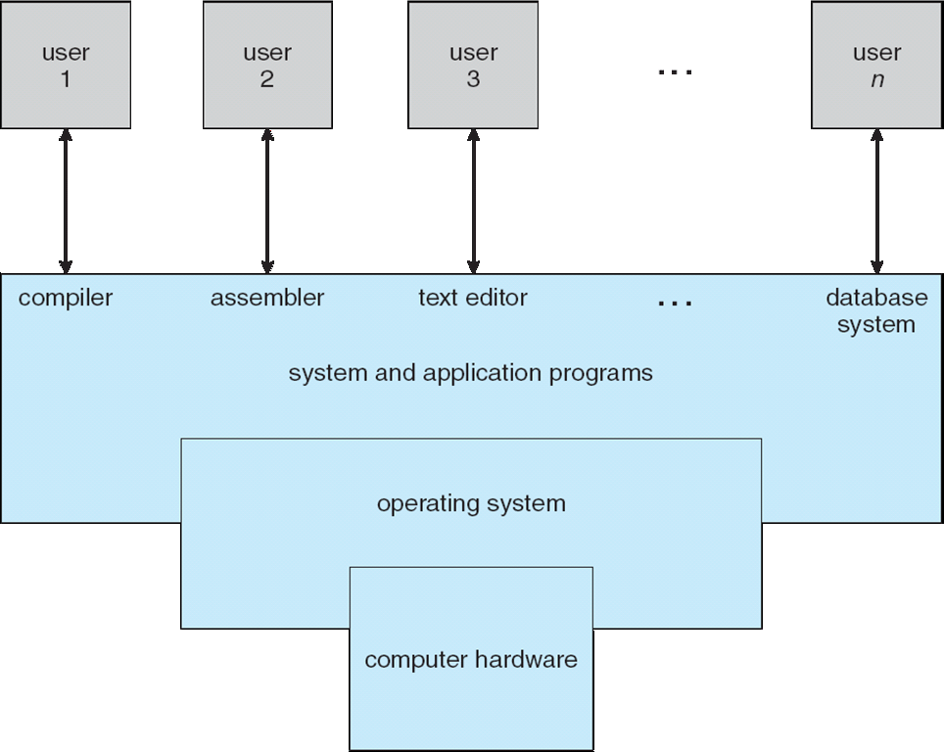
Computer System Structure(6)

Slide 9
Some Useful Definitions(1)
Kernal
kernel is the most important program in the operating system.
“The one program running at all times on the computer”
Everything else is either a system program or an application program.

Slide 10
Some Useful Definitions(2)
System Program:
A program that controls some aspect of the operation of a computer.
used to program the operating system software.
Example: operating system, networking system, web site server, data backup server etc

Slide 11
Some Useful Definitions(3)
System Call:
A system call is the programmatic way in which a computer program requests a service from the kernel of the operating system on which it is executed.
Example: Fork, exec etc.

Slide 12
Some Useful Definitions(4)
Shell:
a shell is a user interface for access to an operating system's services.
In general, operating system shells use either a command-line interface (CLI) or graphical user interface (GUI)

Slide 13
Some Useful Definitions(4)
Program:
A computer program is a collection of instructions that can be executed by a computer to perform a specific task.

Slide 14
What Happens When We Run a Program(1)
A compiler translates high level programs into an
executable file
• The exe contains instructions that the CPU can
understand, and data of the program (all
numbered with addresses)
• Instructions run on CPU: hardware implements
an instruction set architecture (ISA)
• CPU also consists of a few registers, e.g.,
– Pointer to current instruction (program counter or PC)
– Operands of instructions, memory addresses

Slide 15
What Happens When We Run a Program(2)
Exe in
Memory
(RAM)
To run an exe, CPU
– fetches instruction pointed at
by PC from memory
– loads data required by the
instructions into registers
– decodes and executes the
instruction
– stores results to memory
• Most recently used
instructions and data are in
CPU caches for faster access
CPU
PC
Code
Reg.
Data
Reg.
Reg.
Result

Slide 16
So, what does the OS do?
OS manages program
memory
– Loads program executable
(code, data) from disk to
memory
• OS manages CPU
– Initializes program
counter (PC) and other
registers to begin
execution
• OS manages external devices
– Read/write files from disk.
Memory
Disk

Slide 17
OS manages CPU
OS provides the process abstraction
– Process: a running program
– OS creates and manages processes
• Each process has the illusion of
having the complete CPU, i.e., OS
virtualizes CPU
• Timeshares CPU between processes
• Enables coordination between
processes
P1
P2
P3
CPU

Slide 18
OS manages memory
Memory
Of a Process
OS manages the memory
of the process: code, data,
stack, heap etc
• Each process thinks it has a
dedicated memory space
for itself, numbers code
and data starting from 0
(virtual addresses)
• OS abstracts out the details
of the actual placement in
memory, translates from
virtual addresses to actual
physical addresses
0
1
2
.
.
.
.
.
n
Code
Data
RAM
Stack
Heap

Slide 19
OS manages devices
OS has code to manage disk, network card,
and other external devices: device drivers
• Device driver talks the language of the
hardware devices
– Issues instructions to devices (fetch data from a
file)
– Responds to interrupt events from devices (user
has pressed a key on keyboard)
• Persistent data organized as a filesystem on
disk

Slide 20
Interrupt
An interrupt is a signal sent to the processor that interrupts the current process.
It may be generated by a hardware device or a software program.
A hardware interrupt is often created by an input device such as a mouse or keyboard.

Slide 21
Common Functions of Interrupts
Interrupt transfers control to the interrupt service routine generally, through the interrupt vector, which contains the addresses of all the service routines.
Interrupt architecture must save the address of the interrupted instruction.
Incoming interrupts are disabled while another interrupt is being processed to prevent a lost interrupt.
A trap is a software-generated interrupt caused either by an error or a user request.
An operating system is interrupt driven.

Slide 22
Interrupt Handling
The operating system preserves the state of the CPU by storing registers and the program counter.
Determines which type of interrupt has occurred:
polling
vectored interrupt system
Separate segments of code determine what action should be taken for each type of interrupt.

Slide 23
Design goals of an operating system
Convenience, abstraction of hardware
resources for user programs
• Efficiency of usage of CPU, memory, etc.
• Isolation between multiple processes

Slide 24
Thank You

